Slide 1

Diffie-Hellman Key Exchange Algorithm
Malviya National Institute Of Technology, Jaipur
Presentation Topic
Submitted By-
Ronit Verma,
Saumya Gupta,
Ashish Kumar,
Saurabh Shakya,
Aman Mina,
Priya
Submitted To-
Dr. Meenakshi Tripathi,
Associate Professor,
Department of Computer Science & Engineering

Slide 2
Table of Contents
1.
Introduction
The Need for Key Exchange
2.
3.
Types of Cryptography Encryption
4.
Primitives Roots
The Discrete Logarithm Problem
5.
Diffie-Hellman key exchange Algorithm
6.
Advantages of Diffie-Hellman key exchange Algorithm
7.
Potential Vulnerabilities & Applications
8.
Future Scope & Conclusion
9.

Slide 3
Introduction
In today's digital landscape, secure communication stands as a cornerstone of our interconnected world.
As we delve into cryptography, it becomes evident that the means
by which we exchange cryptographic keys play a pivotal role in ensuring the confidentiality and integrity of our communications.

Slide 4
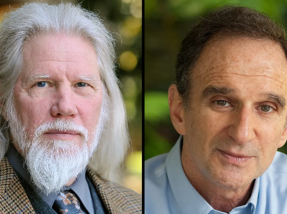
Introduction cont.
The Diffie-Hellman Key Exchange Algorithm was
introduced in 1976 by Whitfield Diffie and Martin Hellman.
It transformed our understanding of sharing cryptographic keys and made it possible to communicate securely without requiring a prior shared secret.
(Whitfield Diffie and Martin Hellman)
Source-Theguardian.com

Slide 5
The Need for Key Exchange
Cryptographic keys are used to encrypt and decrypt messages. If two parties want to communicate securely, they need to share a secret key without revealing it to potential eavesdroppers.
key exchange is fundamental in ensuring the confidentiality, integrity, and authenticity of communications in cryptographic systems.

Slide 6
Types of Cryptography Encryptions
There are two basic techniques for encrypting information:
Symmetric encryption (also called secret key encryption) :
In symmetric encryption, a single secret key is used for both encryption and decryption.
The same key must be kept secret and shared securely between the communicating parties.
E.g. - AES, DES

Slide 7
Types of Cryptography Encryptions cont.
2. Asymmetric encryption (also called public and private key encryption):
In asymmetric encryption, there are two keys: a public key and a private key.
The public key can be freely distributed, while the private key must be kept confidential.
E.g. - RSA
The Diffie Hellman key exchange algorithm is used in asymmetric key cryptography.

Slide 8

Primitive roots
‘g’ is said to be a primitive root of prime number ‘p’,
if :
$g^{1} mod p, g^{2}mod p, g^{3}mod p,…….g^{p−1}mod p$ are distinct.

Slide 9
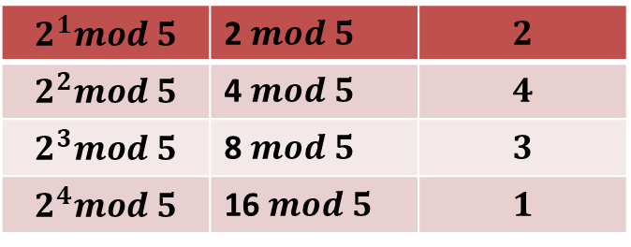
Example 1: is 2 a primitive root of 5 ?
$$2^{1}mod 5$$ | 2 $mod 5$ | $$2$$
$$2^{2}mod 5$$ | 4 $mod 5$ | $$4$$
$$2^{3}mod 5$$ | 8 $mod 5$ | $$3$$
$$2^{4}mod 5$$ | 16 $mod 5$ | $$1$$
Yes, 2 is a primitive root of 5.

Slide 10
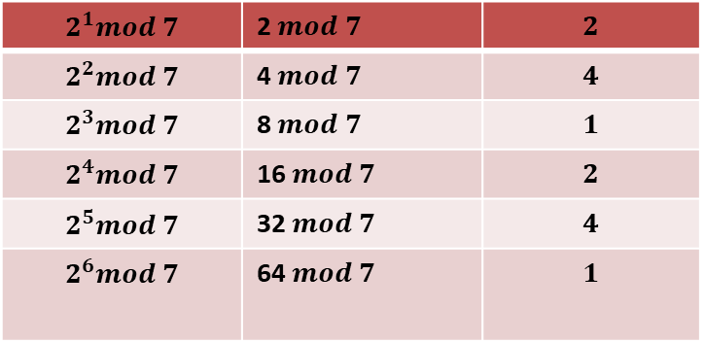
Example 2: is 2 a primitive root of 7 ?
$$2^{1}mod 7$$ | 2 $mod 7$ | $$2$$
$$2^{2}mod 7$$ | 4 $mod 7$ | $$4$$
$$2^{3}mod 7$$ | 8 $mod 7$ | $$1$$
$$2^{4}mod 7$$ | 16 $mod 7$ | $$2$$
$$2^{5}mod 7$$ | 32 $mod 7$ | $$4$$
$$2^{6}mod 7$$ | 64 $mod 7$ | $$1$$
No, 2 is not a primitive root of 7.

Slide 11
The Discrete Logarithm Problem
Analogy
Easy in the forward direction
Milk + Coffee Powder + Sugar = Coffee
Hard in the backward direction

Slide 12
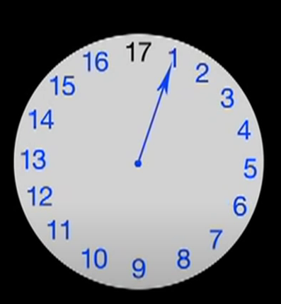

The Discrete Logarithm Problem cont.
1. Let’s take a prime number 17.
2. Primitive roots of 17 are 3, 5, 6, 7, 10, 11, 12, 14
3. Let’s take 3.
4. now
$$3^{1}mod 17=3 \\ 3^{2}mod 17=9 \\ 3^{3}mod 17=10 \\ 3^{4}mod 17=13$$
. .
$$3^{16}mod 17=1$$
The solution is equally likely to be between 1 to 17

Slide 13



The Discrete Logarithm Problem cont.
The reverse procedure is hard –
$$3^{?}mod 17=12$$
This is called the discrete logarithm problem. To find the value of “?” We have to apply brute force and check all values one by one.
easy
$$3^{29}mod 17 \\ 3^{?}mod 17$$
$$12 \\ 12$$
hard

Slide 14
The Discrete Logarithm Problem cont.
How hard is this?
For small numbers it’s easy but if we use a very large prime modulus which is hundreds of digits long. It becomes impractical to solve.
Even if you have all the computational power on earth, it could take thousands of years to check all the possibilities.

Slide 15
The Diffie-Hellman Process
The Diffie-Hellman key exchange unfolds in three key steps, right from its generation up to its transmission.
First, Alice and Bob agree on a large prime number, “p”, and a primitive root modulo p, “g”.
e.g.- p=23 (prime number) and g=11 (primitive number)

Slide 16



Second, each participant randomly generates a private key (a=6 for Alice, b=5 for Bob) and computes a public key (A, B) based on the agreed-upon values of p and g.
The method for computing public keys is as follows:
Public key=$g^{private} mod p$
For alice: $A={11}^{6}mod 23$
$A=9$
For bob: B=${11}^{5}mod 23$
$$B=5$$
These public keys are then exchanged between the participants

Slide 17


To generate the final secret key,
For the sender, the private key (a), the receiver’s public key(B), and the original p is used. The formula to calculate the key is:
$${K1=(receiver^{′}s public key}^{sender′s private key}) mod p$$
$$K1=5^{6}mod 23 \\ K1=8$$

Slide 18


For the receiver, the private key (b), the sender’s public key(A), and the original p is used. The formula to calculate the secret key is
$${K2=(sender^{′}s public key}^{receiver^{′}s private key}) mod p$$
$$K2=9^{5}mod 23 \\ K2=8$$
If both the values of K1 and K2 generated are equal, the Diffie-Hellman key exchange algorithm is complete.

Slide 19








Example
Alice and Bob know and have the following-
P=23 & g=11
Alice chooses a secret random number a=6
Bob chooses a secret random number b=5
Alice computes: $A=g^{a}mod p$
$A={11}^{6}mod 23$; A=9
Bob computes: B$=g^{b}mod p$
$B={11}^{5}mod 23$; B=5
Alice receives B=5 from Bob
Bob receives A=9 from Alice
Secret Key = K = $B^{a}mod p$
Secret Key = K = $A^{b}mod p$
$$K=5^{6}mod 23=8$$
$$K=9^{5}mod 23=8$$
The common secret key is: 8

Slide 20
Advantages of Diffie-Hellman key exchange Algorithm
The security considerations of the Diffie-Hellman key exchange algorithm are crucial to understanding its robustness in facilitating secure communication
Resistance to Eavesdropping: The algorithm is designed to resist eavesdropping attacks. Even if an adversary intercepts the public keys exchanged between parties, deriving the shared secret without knowledge of the private keys, which are never transmitted, remains computationally infeasible due to the discrete logarithm problem.

Slide 21
Advantages of Diffie-Hellman key exchange Algorithm cont.
Randomness of Private Keys: Another assumption is the randomness of the private keys chosen by the communicating parties. If private keys are predictable or generated with insufficient entropy, it could introduce vulnerabilities.
By relying on the assumed complexity of certain mathematical problems, the algorithm provides a powerful and practical solution for secure key exchange.

Slide 22
Potential Vulnerabilities:
Man-in-the-Middle Attacks: A potential vulnerability is the susceptibility to man-in-the-middle attacks, where an adversary intercepts and alters the public keys exchanged between Alice and Bob. To mitigate this, additional measures such as digital signatures or public key infrastructure (PKI) can be incorporated to verify the authenticity of the exchanged keys.

Slide 23
2. Quantum Threats: While not an immediate concern with current technology, the advent of quantum computers poses a potential threat to Diffie-Hellman. Quantum algorithms, such as Shor's algorithm, could efficiently solve the discrete logarithm problem, compromising the algorithm's security. Future-proofing cryptographic systems involves exploring post-quantum cryptographic alternatives.
3. Small Subgroup Attack: Another consideration is the small subgroup attack, where an attacker exploits weaknesses in the choice of parameters (specifically, the generator g and the prime p). Ensuring the selection of robust parameters is crucial to thwarting such attacks.

Slide 24
Applications
The Diffie-Hellman key exchange, with its ability to establish secure communication over insecure channels, finds widespread application in real-world scenarios.
SSL/TLS Protocols
- often used in conjunction with SSL/TLS protocols to establish a secure connection between a client and a server.
SSH (Secure Shell)
- Diffie-Hellman is commonly used in the SSH protocol for secure remote login and file transfer.

Slide 25
Applications
3. Blockchain and Cryptocurrencies
- Some blockchain systems, like Bitcoin, use elliptic curve Diffie-Hellman (ECDH) for key exchange in creating public and private key pairs
Wireless Security
- Diffie-Hellman is used in securing wireless communication, such as in WPA (Wi-Fi Protected Access) protocols. It helps in establishing a secure key for encrypting data between a wireless access point and a device

Slide 26
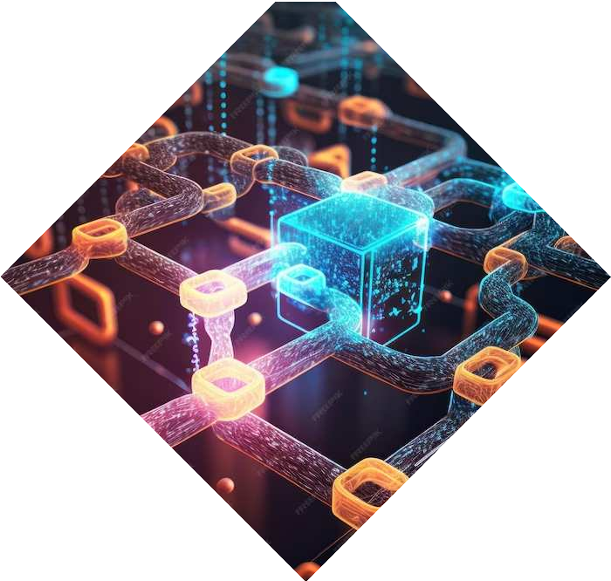
Future Scope
The algorithm can be refined in parameter choices, algorithm variations, or new approaches that bolster the algorithm's resistance to evolving threats.
Some of the potential areas where the algorithm can further be enhanced are:
Quantum Computing Implications
The advent of quantum computing introduces a significant consideration for the future of Diffie-Hellman. While the algorithm relies on the presumed difficulty of the discrete logarithm problem, quantum algorithms have the potential to efficiently solve this problem, jeopardizing the security it provides.

Slide 27
Future Scope cont.
Algorithmic Improvements
the Diffie-Hellman algorithm can be enhanced on the factors such as key generation speed and computational resources
Parameter Selection Guidance:
Providing clearer guidance on parameter selection, and considering various deployment scenarios, can contribute to better security practices.

Slide 28
Conclusion
In closing, the Diffie-Hellman key exchange algorithm stands as a resilient pillar in the realm of cryptography, enabling secure communication without the need for a pre-shared secret. Its strengths in resisting eavesdropping and its versatility in applications from internet security to remote access underscore its significance. As we look ahead, ongoing research, potential improvements, and the quantum computing challenge underscore the dynamism of this foundational algorithm.

Slide 29
Thank You!
Do you have any questions?

